Slide 1
CUA REU: Week 1 Abstract
Antonio Perillo

Slide 2
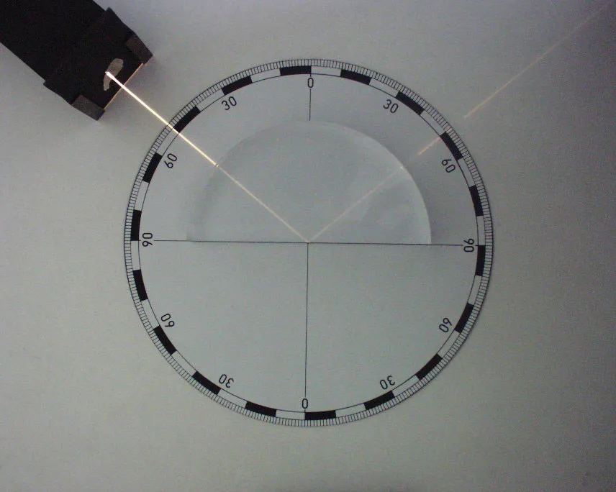
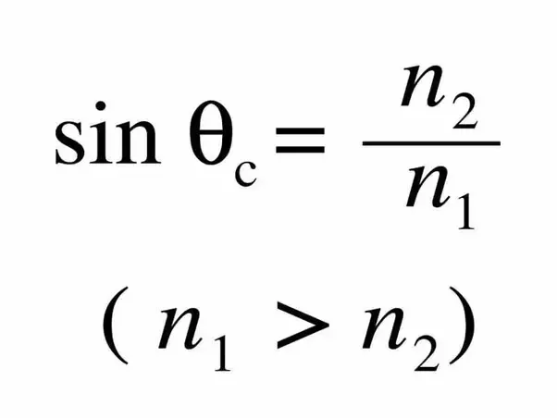
Theory and Experiment
Scintillating Crystals
Electromagnetic Calorimetry
Light Yield
Distinguishing Crystals (Looking Forward)

Slide 3
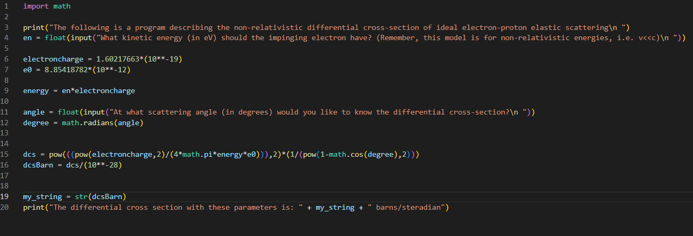
Computation

Slide 4
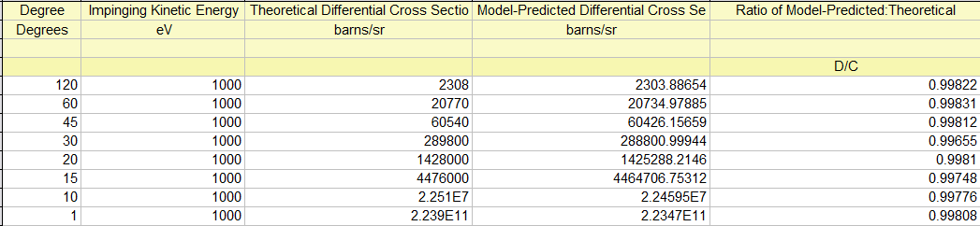
Results
https://digital.library.unt.edu/ark:/67531/metadc865143/m2/1/high_res_d/4067467.pdf

Slide 5
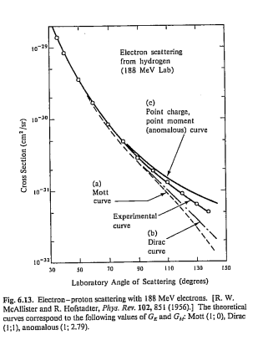
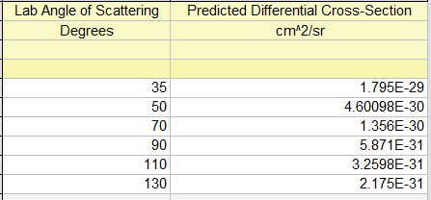
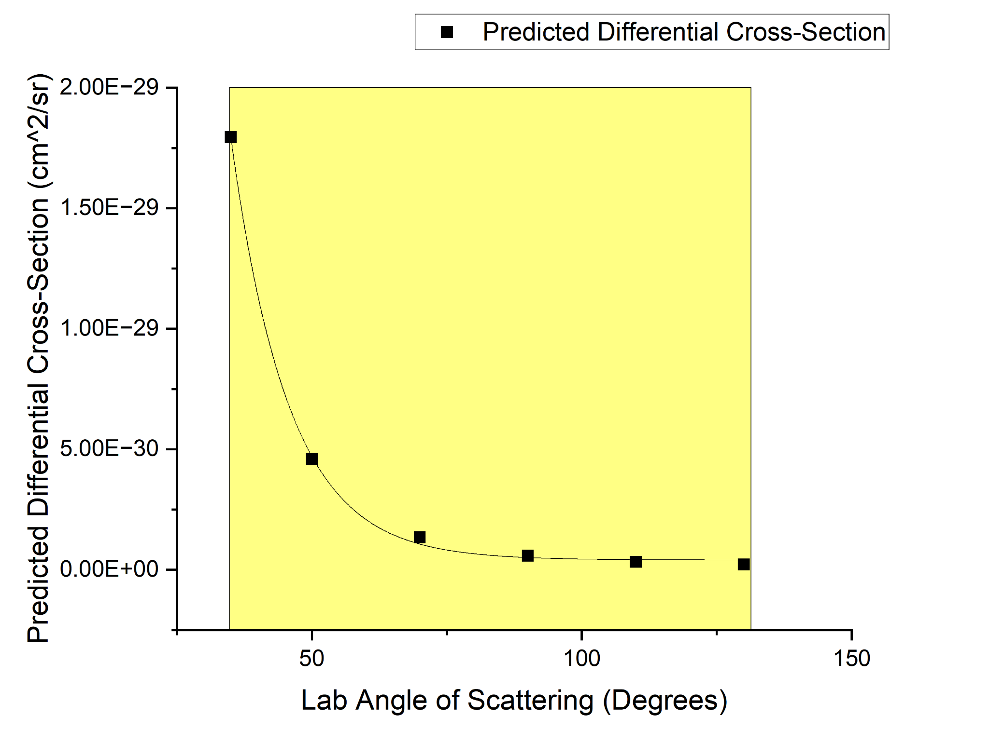
Further Results
https://www.physics.utoronto.ca/~krieger/DIS_Tutorial.pdf

Slide 6
References
Storm, E. & Hancock, J. H. Electron elastic scattering cross sections from 1 keV to 100 MeV for elements Z = 1 to 100, report, April 1, 1975; New Mexico. (https://digital.library.unt.edu/ark:/67531/metadc865143/: accessed May 30, 2024), University of North Texas Libraries, UNT Digital Library, https://digital.library.unt.edu; crediting UNT Libraries Government Documents Department
https://www.physics.utoronto.ca/~krieger/DIS_Tutorial.pdf

Slide 7
Notes
More precise way of determining differences in experimental results and predicted results using code

